Slide 1

KAAS Umbrella
The next gen backpack umbrella

Slide 2
TEAM DETAILS:
KASHISH SINGHAL 21H51A1247
A.SANDHYA GAYATRI 21H51A1245
E.ANIRUDH 21H51A1208
V.ADITYA 21H51A1219

Slide 3
NEed STATEMENT:
Nowadays due to changing climatic conditions it's hard to predict the weather conditions. Given such unpredictable weather it’s hard to take precautions everyday. We have to carry an umbrella always irrespective of the weather. Carrying it in hand every time is also a problem. This problem is for students and working people. So there is a need of an umbrella which doesn’t required to be held in hands.

Slide 4
INTRODUCTION:
In the rainy season, an umbrella is a must-have item. The issue with umbrellas is that they must be carried separately from your other belongings and need the use of one hand at all times. Also, umbrellas need to be kept separately in buckets, which leads to individuals forgetting about them and losing them in many situations. So, with a meet its objectives, we develop a smart solution to all umbrella-related concerns. Our suggested product is a backpack pack with an integrated umbrella that detects rain automatically. The umbrella does not need to be held separately, and the user has full use of both hands even when the umbrella is open.

Slide 5
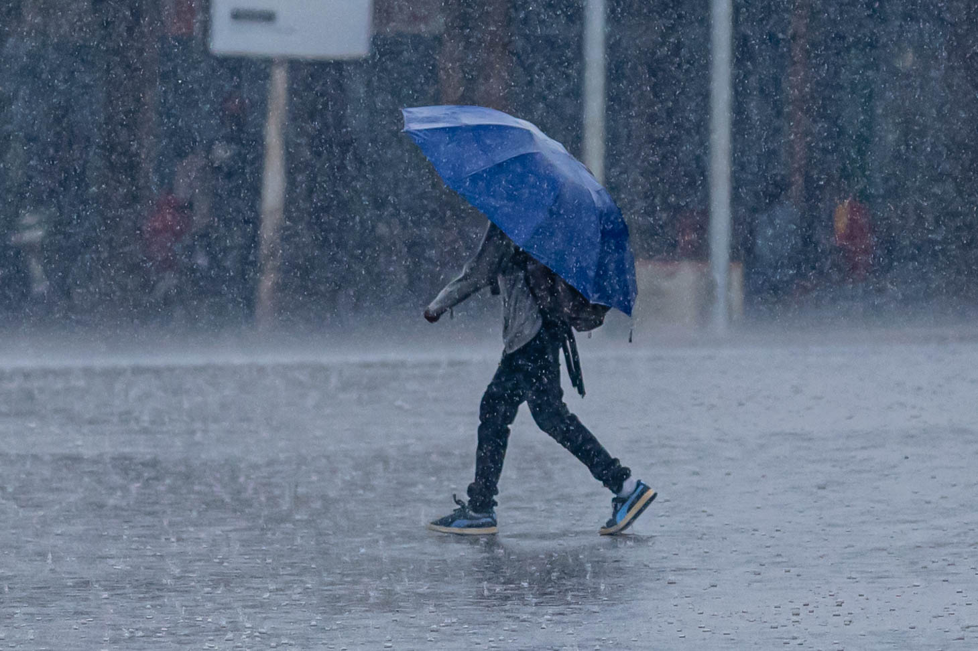
EXISTING SOLUTIONS:
1. Traditional Umbrella
The widely used solution by most of the population in the world is “AN UMBRELLA”. It has been around since ancient times.
Advantages:
It is affordable by most of the different economical classes.
It is useful for both Summer and Rainy seasons.
Disadvantages:
We have to carry it everywhere irrespective of the weather.
An Umbrella can only help one person from soaking wet.
It is an additional gear.

Slide 6
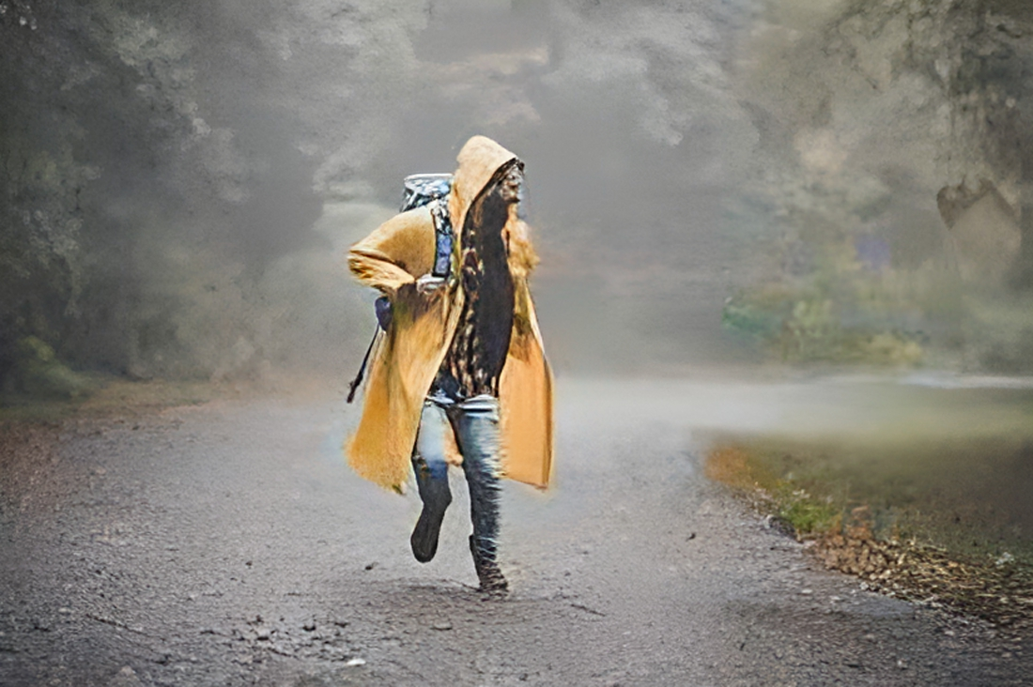
2. Raincoat
This is a wearing gear for the people to not soak wet in rain.
Advantages:
Helps the person cover his entire body in order to protect him from rain.
Easy to carry everywhere.
Disadvantages:
Covers entire body of a person but not his accessories.
Takes time to wear.

Slide 7

3. Hats/Caps
This is a head gear helpful for preventing your head getting wet due to rain.
Advantages:
It helps in preventing with rain obstructing our view
Easy to carry and trendy.
Disadvantages:
Only protects the head from soaking wet not the entire body.
Wearing a head cap for an extended period of time can damage your hair and trap its natural oils, making them dry.

Slide 8

4. Puffer Jackets
This is also similar to raincoat but it only covers the torso.
Advantages:
It covers the torso region from soaking wet
It can be used during winter and rainy seasons.
Easy to carry and trendy.
Disadvantages:
Only protects the torso from getting wet not the entire body.
Cannot help accessories from getting wet.

Slide 9
COMPONENTS REQUIRED:
Umbrella Cloth
Metal Rods
Servo Motors
Rechargeable Battery
Arduino UNO
Jumper wires
Push Button
Bag pack

Slide 10
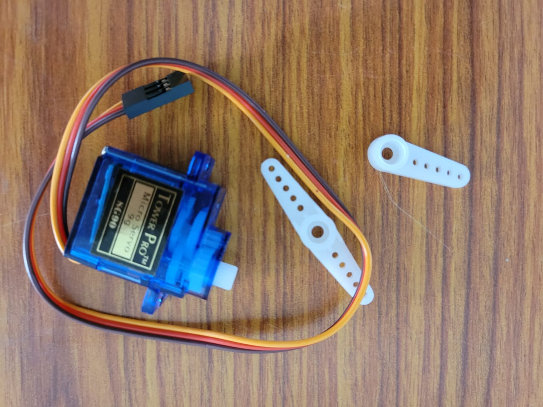
Servo Motors:
The servo motor is an electrical motor that uses control electronics to continuously determine accurate locations, speeds, and torque (servo controller). Precision customization and programming for the motor's actuation are also made possible via a desktop application with the control electronics, offering a high level of dynamism and originality.

Slide 11
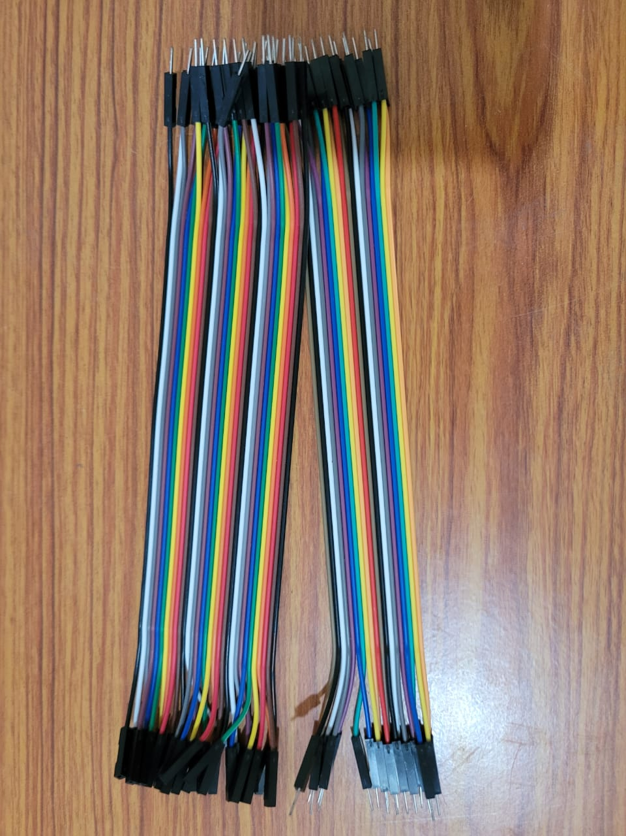
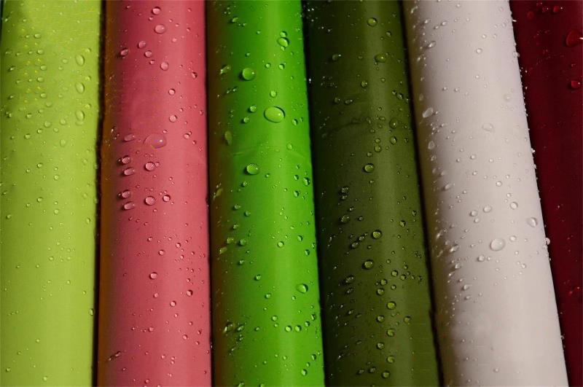
Jumper Wires
Simply said, jumper wires are cables having connector pins at every end that may be used to link two places without soldering. With the use of a breadboard and other prototype equipment, jumper wires are frequently utilized to make it simple to alter a circuit as required. Pretty easy. Jumper wires are among the most fundamental items there is.
Umbrella cloth(raincoat cloth)
Its purpose is to shield the user from the rain. The fabric of the garment is of high quality. The fabric is environmentally friendly.

Slide 12
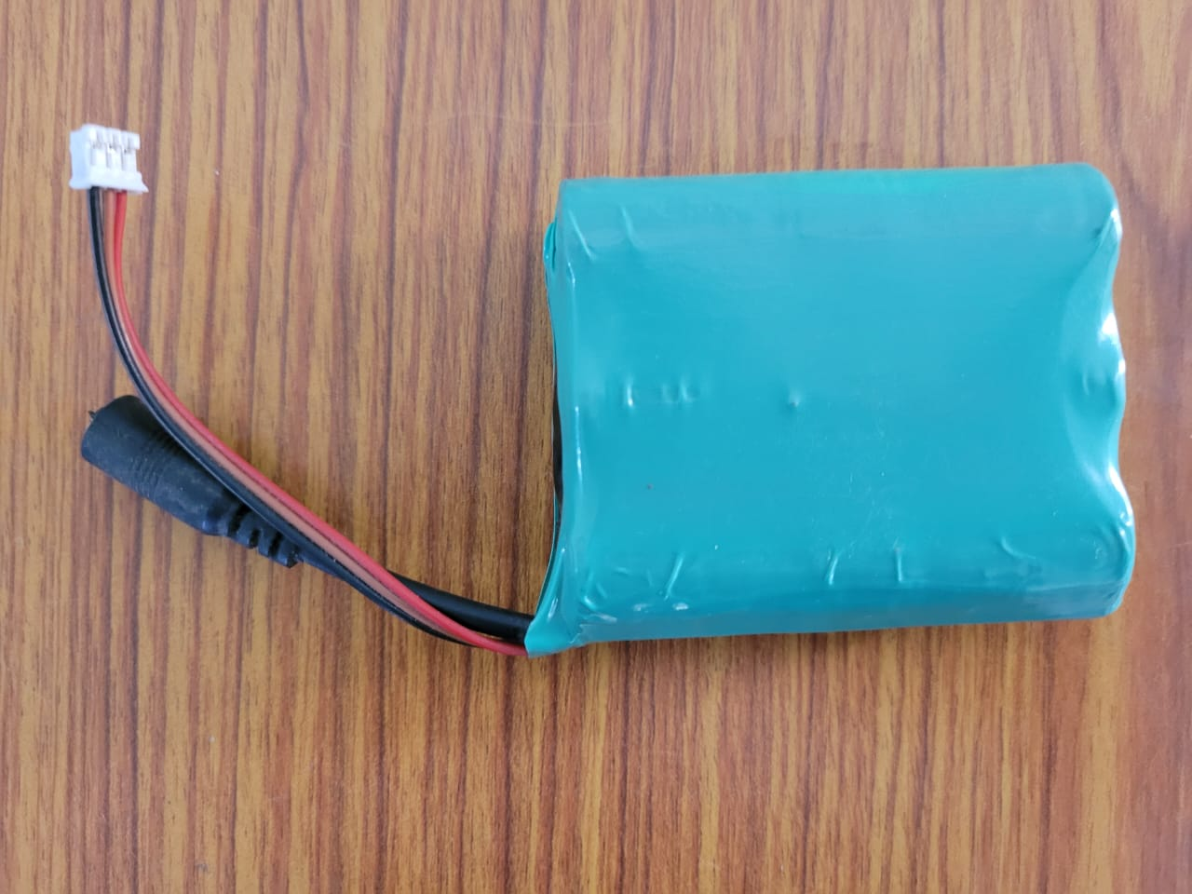
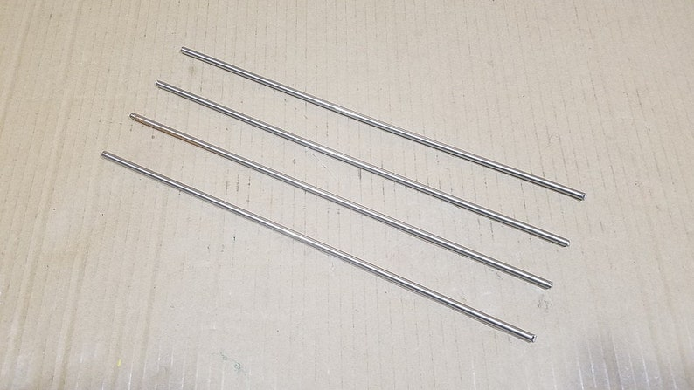
Battery:
A battery is a type of energy source that is made up of one or more rechargeable batteries with terminals on both ends known as an anode (-) and a cathode (+). Chemical energy is converted into electrical energy by electrochemical cells. An electrolyte, which is commonly composed of salts or acids, is included within the battery and acts as a conducting medium, permitting the electric charge to move through the battery.
Thin metal rods
It serves to support and support the umbrella's design. On top, it may also be utilized to create the appearance of an umbrella.

Slide 13
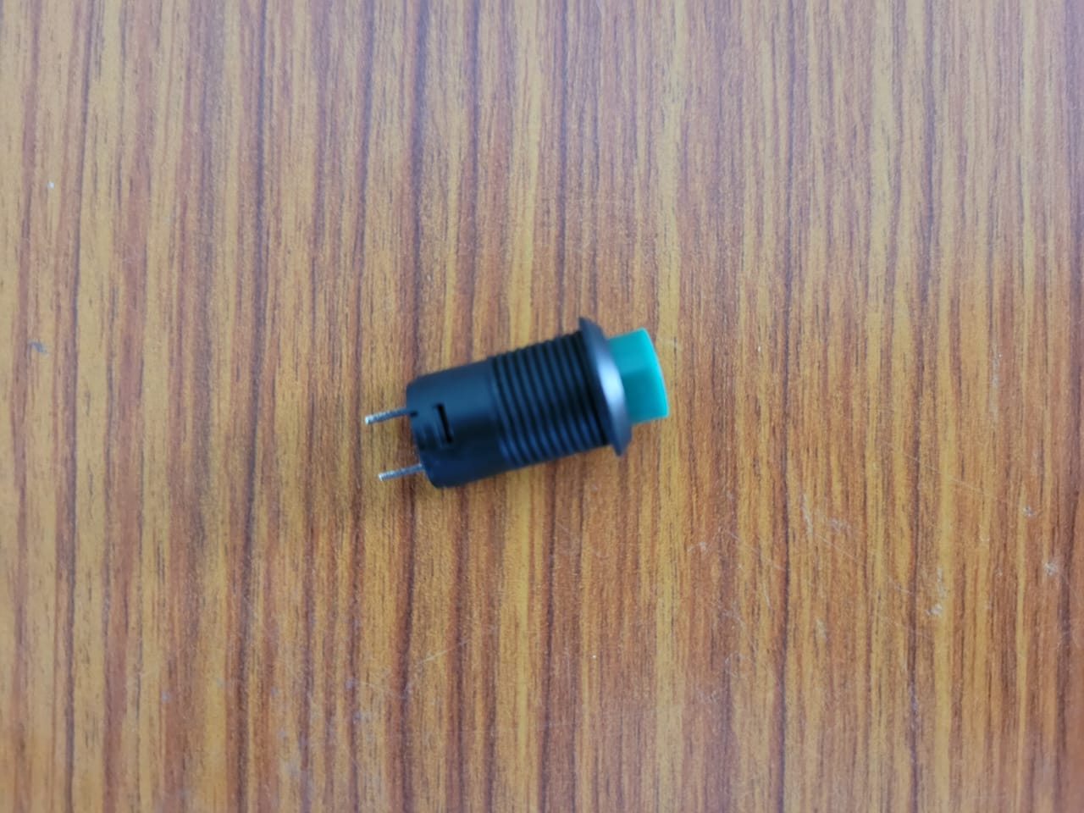
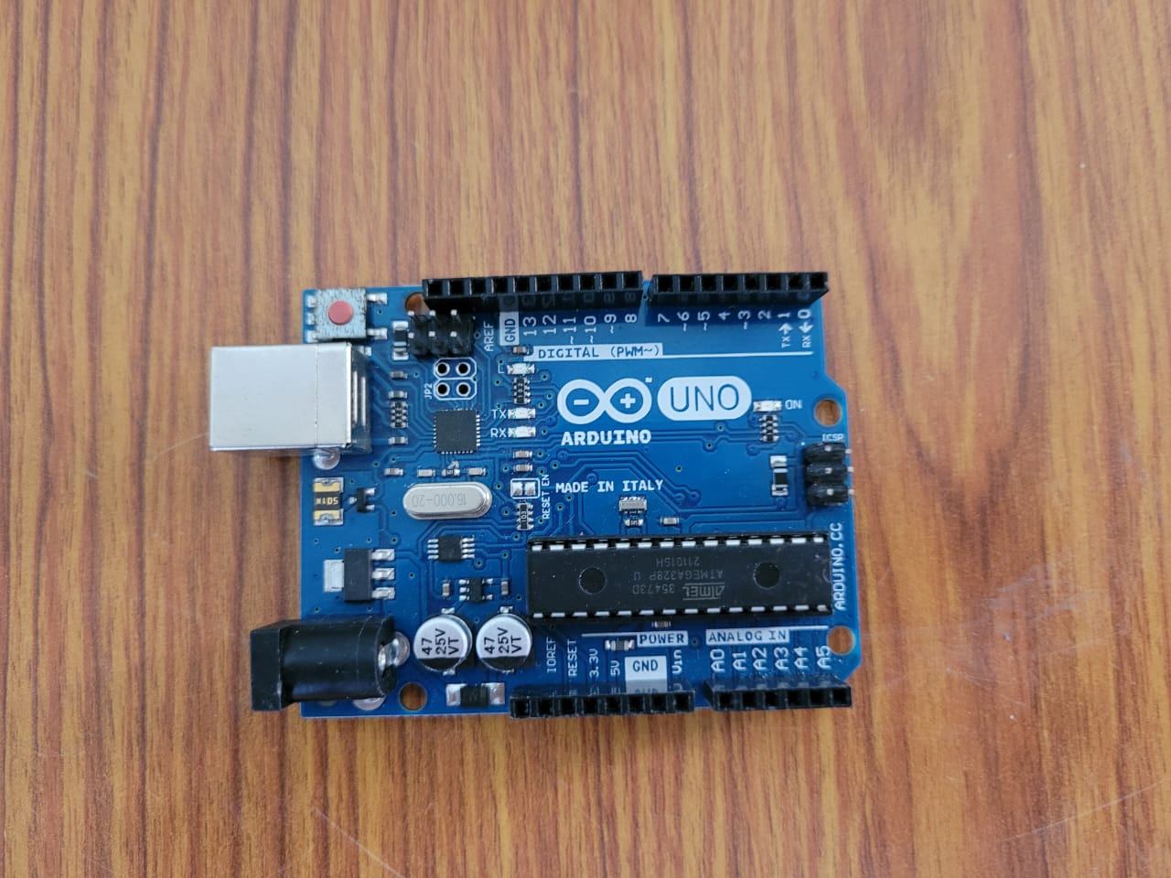
Push Button
A push-button (sometimes written pushbutton) is a basic switch mechanism used to control some component of a machine. Buttons are usually constructed of a hard substance, such as metal or plastic. The surface is often flat or contoured to accommodate the individual finger or palm, allowing it to be depressed or pushed effortlessly.
Arduino UNO
An ATmega328p microcontroller is used in the Arduino Uno, a particular type of Arduino board that is made available as open-source hardware. The Arduino Uno has a number of input and output analogue and digital pins that are used to attach the board to other parts. Six of the fourteen I/O pins installed inside are analogue input pins. A USB connector on the board may be utilized to deliver power to it. The board is used to develop circuits for electronics applications.

Slide 14
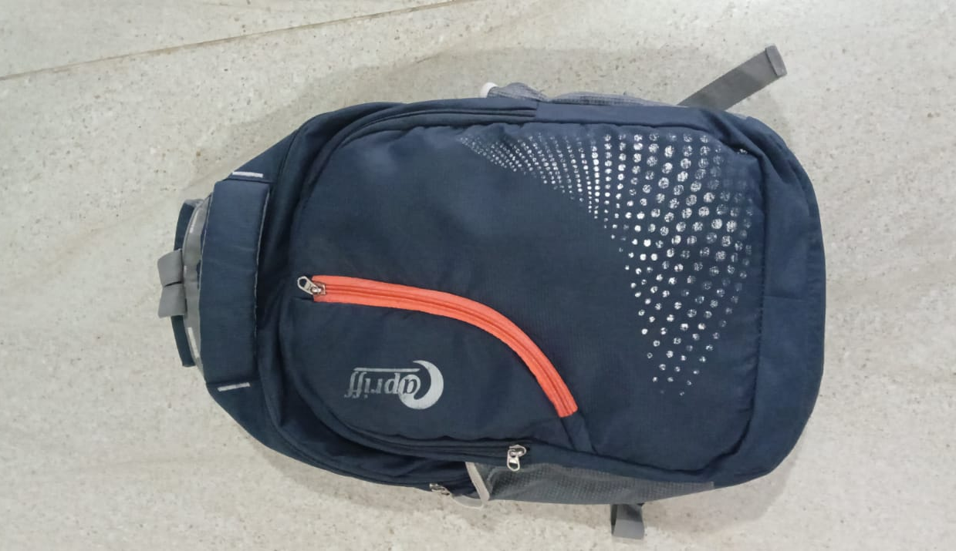
Backpack
A backpack is a simplest frameless form, a fabric sack carried on one’s back and secured with two straps that go over the shoulders, but it can have an external frame, internal frame, and there are bodypacks.

Slide 15
Budget analysis
The total cost for the complete project is around 2500/-

Slide 16
BLOCK DIAGRAM:
Power Supply
Switch
Micro Controller
Servo Motor

Slide 17
Working mechanism:
The modernized umbrella is made up of a DC motor system with a clear plastic cover, a rain sensor, and an Arduino controller built inside a bag pack. The rain detecting umbrella system is an unique modern device that changes the way umbrellas are used. The rain sensor detects the presence of rain. When rain is detected, the sensor sends a trigger signal to the Arduino controller. The microcontroller now controls the motors that open the little umbrella shed, shielding the user from rain. A user can also initiate umbrella opening and shutting operations by pressing a button.

Slide 18
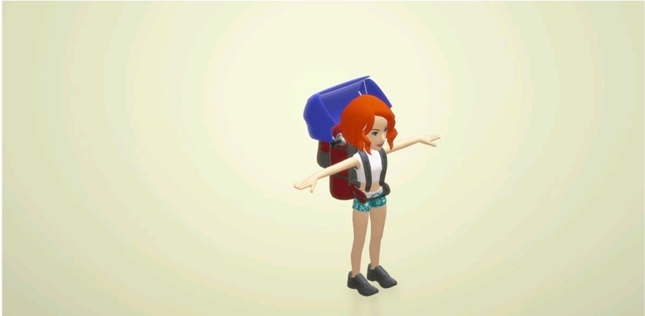
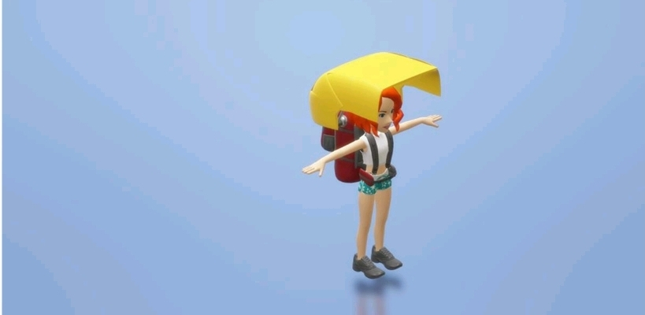

Slide 19
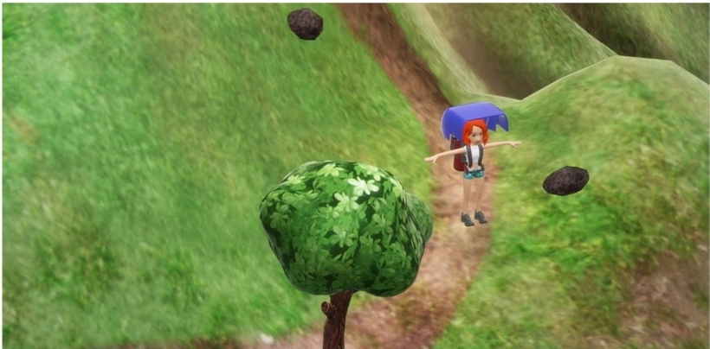


Slide 20
ADVANTAGES:
• Single click operation
• Bag-attached umbrella eliminates the need to carry a separate umbrella
• No chance of forgetting or losing the umbrella
• Automatic opening and shutting on button touch
• Rain and sunshine protection as needed

Slide 21
DISADVANTAGES:
• The battery life is restricted.
• It exclusively protects the person who is carrying the bag.

Slide 22
CONCLUSION
After completing the present work with all the process involved in designing the automated umbrella which can be of reasonable cost analysis and effective way to providing the shelter and safety to the person
This type of umbrella should be used by students and work people in order to protect themselves from rain.
The designed system prototype can be used along with the renewable source of energy.
The designed model is not only smart but also intelligent as it will take decision about folding and unfolding of umbrella.
The system can be controlled by Arduino and a set of servo motors which help in rotation motion of the roof the model

Slide 23
REFERENCES
https://www.quickcompany.in/patents/rain-sensing-umbrella-rain-sensing-hands-free-auto-open-closed-umbrella-bag#documents
https://risingsealevel.wordpress.com/the-other-one/
https://youtu.be/cLdQXfJ2XeA

Slide 24
THANK YOU

